Slide 1

Writing a body paragraph
Paragraphs for your supporting arguments!

Slide 2
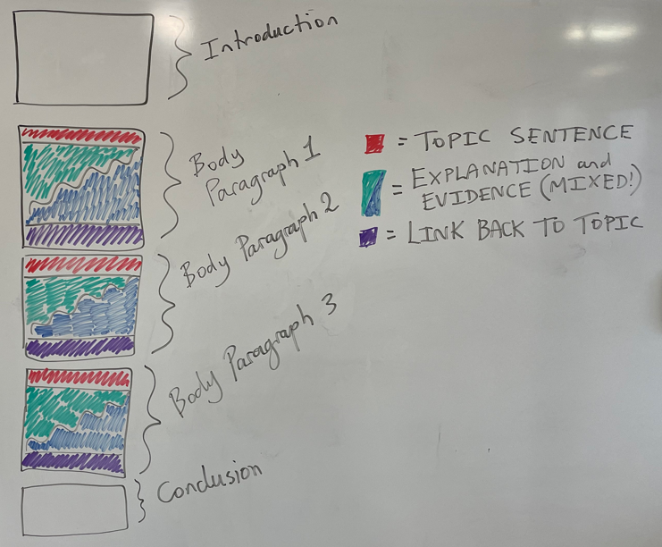
The middle paragraphs are where you expand on the ideas you introduced in your introduction

Slide 3
Example introduction:
The novel The Bone Sparrow written by Zara Fraillon explores themes of love and hope. The story suggests that the most important thing in the world is friendship, this is displayed and proven throughout the text. Subhi’s friendship with Eli got him through nine years of living in the detention centre. Even his relationship with older characters like Nasir and Harvey brought happiness to Subhi’s life. Furthermore, the most crucial friendship of the novel, with Jimmie, made great pain, loss and suffering something Subhi was able to get through because he had people by his side. The Bone Sparrow teaches that challenges and hardships are saved by friendship.

Slide 4
Example introduction:
The novel The Bone Sparrow written by Zara Fraillon explores themes of love and hope. The story suggests that the most important thing in the world is friendship, this is displayed and proven throughout the text. Subhi’s friendship with Eli got him through nine years of living in the detention centre. Even his relationship with older characters like Nasir and Harvey brought happiness to Subhi’s life. Furthermore, the most crucial friendship of the novel, with Jimmie, made great pain, loss and suffering something Subhi was able to get through because he had people by his side. The Bone Sparrow teaches that challenges and hardships are saved by friendship.
Idea 1 Idea 2 Idea 3 ← each idea will be expanded in a paragraph

Slide 5

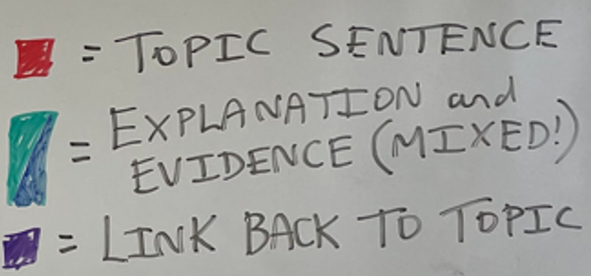
Structure of a body paragraph
Begin with a TOPIC SENTENCE
Expand on your topic with further EXPLANATION and EVIDENCE (quotes) from the novel
Finish by LINKING BACK to your topic

Slide 6
Example introduction:
The novel The Bone Sparrow written by Zara Fraillon explores themes of love and hope. The story suggests that the most important thing in the world is friendship, this is displayed and proven throughout the text. Subhi’s friendship with Eli got him through nine years of living in the detention centre. Even his relationship with older characters like Nasir and Harvey brought happiness to Subhi’s life. Furthermore, the most crucial friendship of the novel, with Jimmie, made great pain, loss and suffering something Subhi was able to get through because he had people by his side. The Bone Sparrow teaches that challenges and hardships are saved by friendship.
Idea 1 Idea 2 Idea 3 ← each idea will be expanded in a paragraph

Slide 7
Idea 1: Subhi’s friendship with Eli got him through nine years of living in the detention centre.
Part of paragraph | Plan
Topic Sentence | Throughout The Bone Sparrow it is made clear that Subhi looks up to Eli as an older brother figure, and relies on him to cope and survive the detention centre, emphasising the importance of friendship in difficult circumstances.
Further Explanation | Eli teaches Subhi how to resist the overwhelming dreariness of the detention camp, by running packages, criticising the jackets, and standing up to other detainees who treat Subhi with cruelty.
Evidence from the novel | “Because Eli, he made everything OK.” (p. 67) “Eli calls us partners” (p. 25) “Eli always tells me ‘never let anyone see your scared’” (p.33)
Link back to the topic | Eli’s death impacts Subhi greatly, however Subhi remains inspired by Eli’s bravery and is able to recount the events of “the craziness” to Sarah, which likely leads to Subhi, his Maa, and Queeny being moved out of the camp.

Slide 8
Idea 1: Subhi’s friendship with Eli got him through nine years of living in the detention centre.
Part of paragraph | Plan
Topic Sentence | Throughout The Bone Sparrow it is made clear that Subhi looks up to Eli as an older brother figure, and relies on him to cope and survive the detention centre, emphasising the importance of friendship in difficult circumstances.
Further Explanation | Eli teaches Subhi how to resist the overwhelming dreariness of the detention camp, by running packages, criticising the jackets, and standing up to other detainees who treat Subhi with cruelty.
Evidence from the novel | “Because Eli, he made everything OK.” (p. 67) “Eli calls us partners” (p. 25) “Eli always tells me ‘never let anyone see your scared’” (p.33)
Link back to the topic | Eli’s death impacts Subhi greatly, however Subhi remains inspired by Eli’s bravery and is able to recount the events of “the craziness” to Sarah, which likely leads to Subhi, his Maa, and Queeny being moved out of the camp.
Now it needs to be put all together – The challenge is making sure your quotes flow smoothly in your sentences!

Slide 9
Idea 1: Subhi’s friendship with Eli got him through nine years of living in the detention centre.
Throughout The Bone Sparrow it is made clear that Subhi looks up to Eli as an older brother figure, and relies on him to cope and survive the detention centre, emphasising the importance of friendship in difficult circumstances. Eli, who “made everything OK”, teaches Subhi how to resist the overwhelming dreariness of the detention camp. Subhi recounts how Eli referred to them both as “partners” when running packages, criticising the jackets, and standing up to other detainees who treat Subhi with cruelty. Subhi learns from Eli to “never let anyone see your scared”, which proves critical when Subhi is required to bravely escape the detention centre to save Jimmie’s life. Eli’s death impacts Subhi greatly, however Subhi remains inspired by Eli’s bravery and is able to recount the events of “the craziness” to Sarah, which likely leads to Subhi, his Maa, and Queeny being moved out of the camp.

Slide 10
Idea 1: Subhi’s friendship with Eli got him through nine years of living in the detention centre.
Throughout The Bone Sparrow it is made clear that Subhi looks up to Eli as an older brother figure, and relies on him to cope and survive the detention centre, emphasising the importance of friendship in difficult circumstances. Eli, who “made everything OK”, teaches Subhi how to resist the overwhelming dreariness of the detention camp. Subhi recounts how Eli referred to them both as “partners” when running packages, criticising the jackets, and standing up to other detainees who treat Subhi with cruelty. Subhi learns from Eli to “never let anyone see your scared”, which proves critical when Subhi is required to bravely escape the detention centre to save Jimmie’s life. Eli’s death impacts Subhi greatly, however Subhi remains inspired by Eli’s bravery and is able to recount the events of “the craziness” to Sarah, which likely leads to Subhi, his Maa, and Queeny being moved out of the camp.
This is a finished body paragraph!

